Slide 1
Got a CMS? Get Your Webdevmojo Back with JavaScript!
2014 Minnesota Government IT Symposium
For State Agencies, Counties, Cities, Higher Education and Nonprofits
December 9-11, 2014 RiverCentre, St. Paul, MN www.mngts.org/itsym
(Presented by GTS Educational Events)
Session 31
Got a CMS? Get Your Webdevmojo Back with JavaScript!
Paul Burtness, Anoka County, MN
Wednesday, December 10, 2014
2:00 p.m. – 3:00 p.m.
Presentation and code examples at:
http://paul-burtness.github.io/webdevmojo/

Slide 2
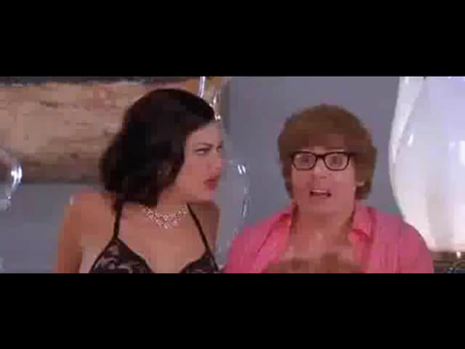
Lost your mojo?

Slide 3

What is it?
Mojo – a power that may seem magical and that allows someone to be very effective
Webdevmojo – the ability to solve problems in an amazing way using web applications...

Slide 4


Slide 5

How do you lose it?

Slide 6
How do you lose it?
Migrate your website from a self-hosted site you build and control…
To a managed-hosting site built with a 3rd-party Content Management System (CMS)
Pros – no longer responsible for managing a server, distributed authoring, etc.
Cons – format limitations, limited to built-in functions

Slide 7
How do you get it back?
Contract with vendor to customize the CMS
Modify the CMS yourself
Build applications on another server
Integrate your applications with the CMS demo – http://www.anokacounty.us/InmateLocator

Slide 8
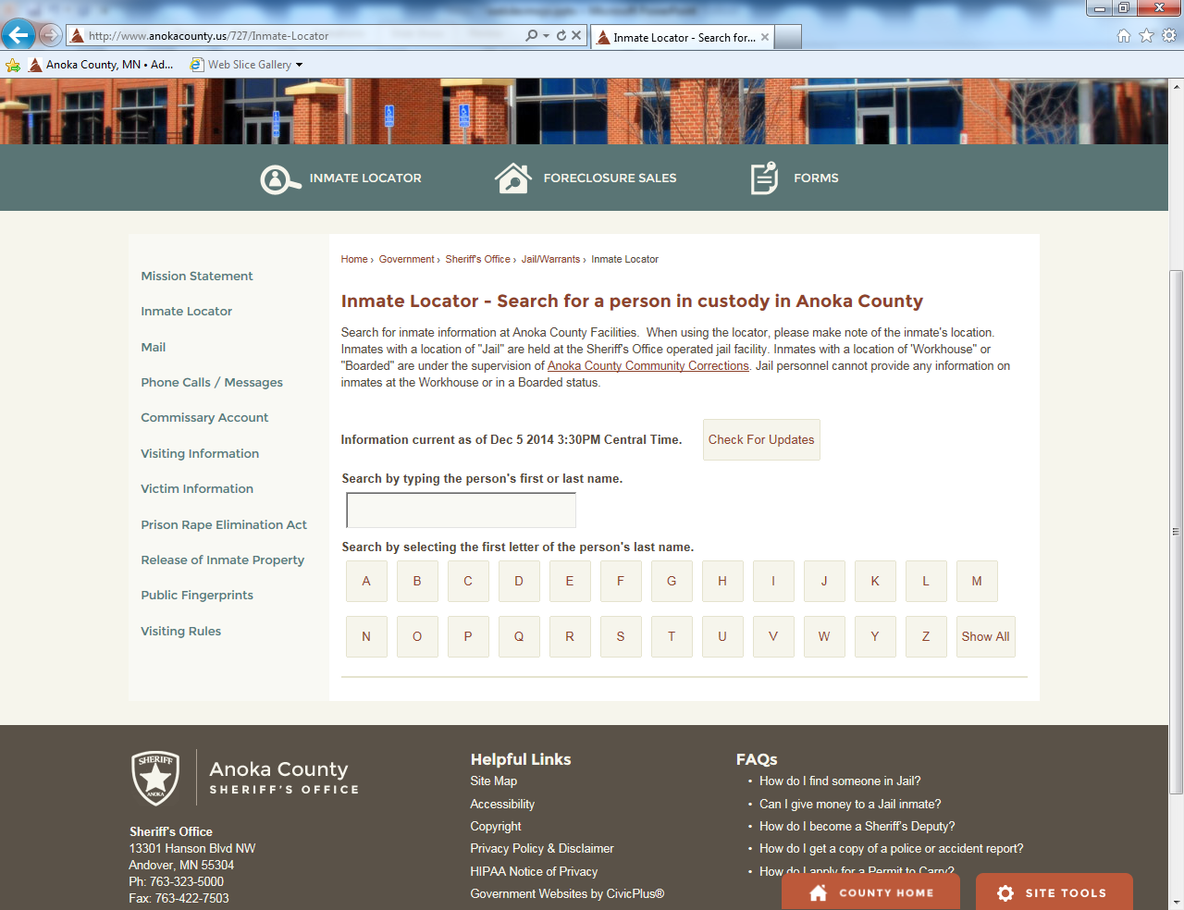

Slide 9
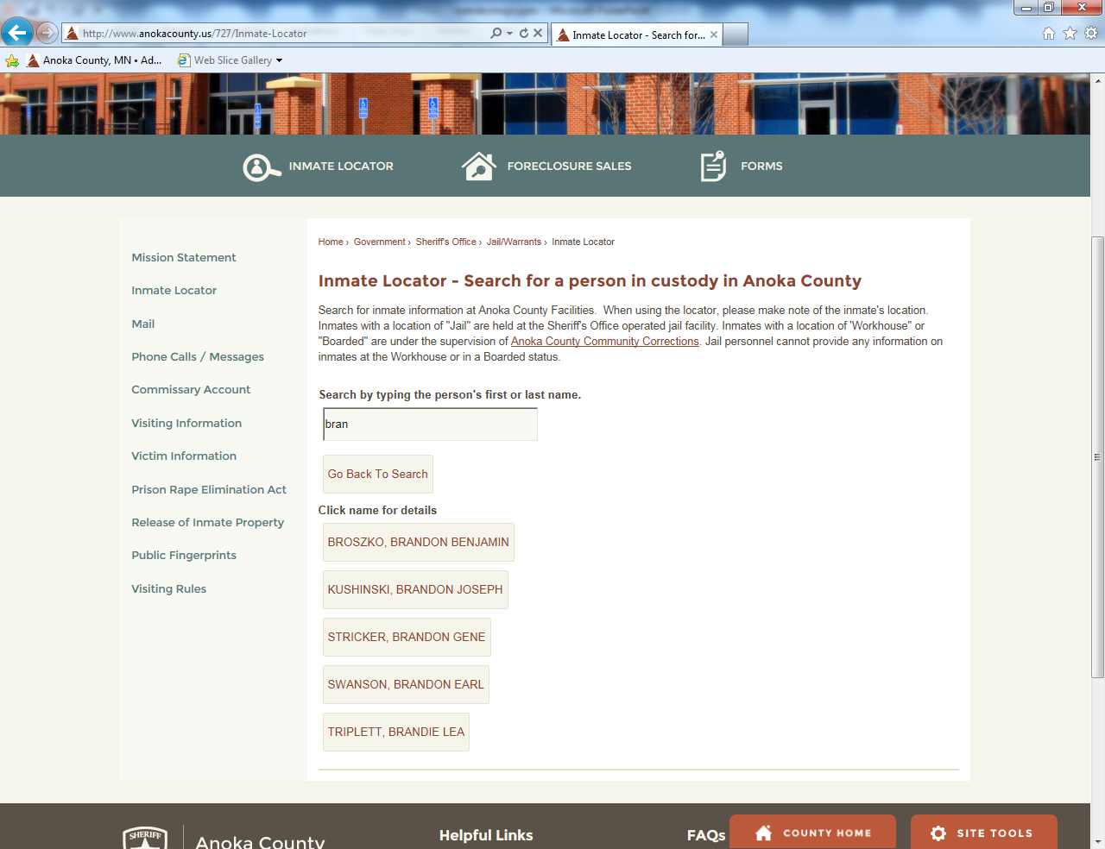

Slide 10
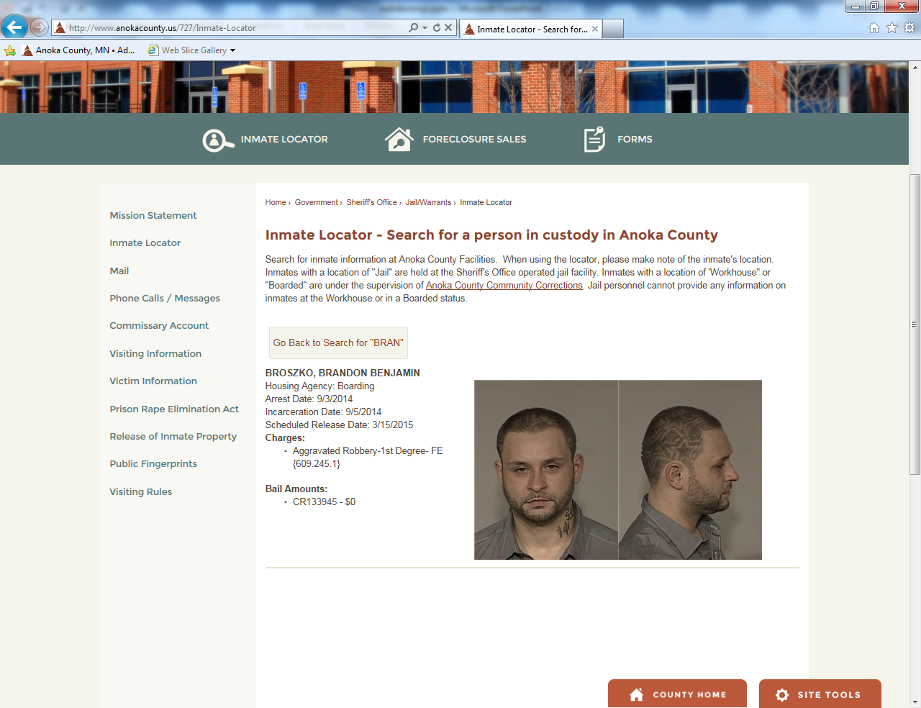

Slide 11


Slide 12

Why JavaScript?
Flash – security issues, no iOS support
Java – runtime issues, learning curve
JavaScript – universal support, appropriate for wide range of solutions, approachable

Slide 13
How do you play?
<html>
<head>
<title>My JavaScript Page</title>
<script type="text/javascript" src="http://yourserver.com/js/script.js">
</script>
</head>
<body>
<h1>
<script type="text/javascript">
document.write("Hello World");
alert("It worked!");
</script>
</h1>
</body>
</html>

Slide 14
Can you play?
Probably cannot access <head> section
Need to get <script> code into the <body> of the HTML
Rich text editor with HTML editing or a Custom HTML editor
Put in a new page and try it (test version?)
Does it display? Does it cause an error?
demo – http://www.anokacounty.us/tryit

Slide 15
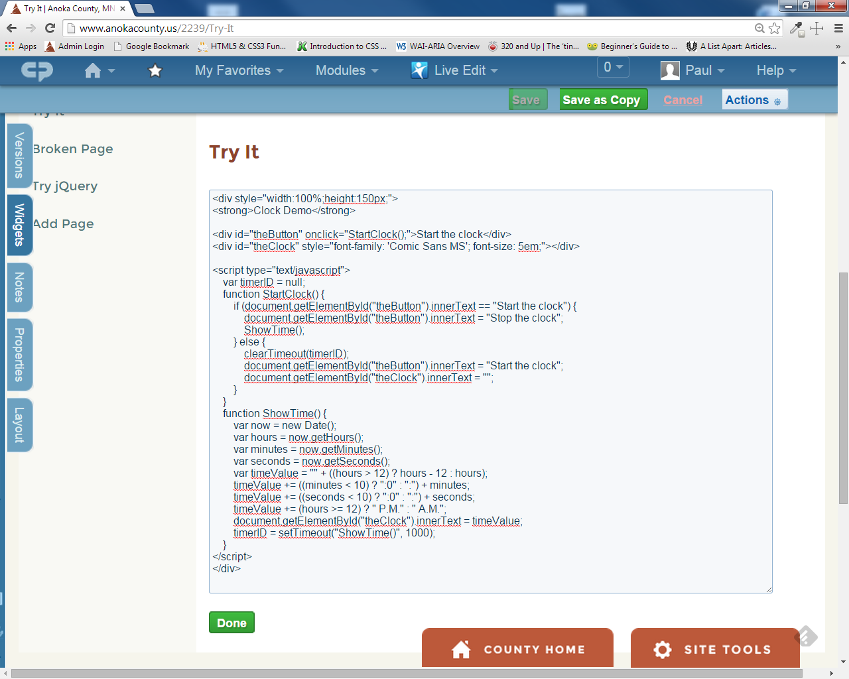

Slide 16
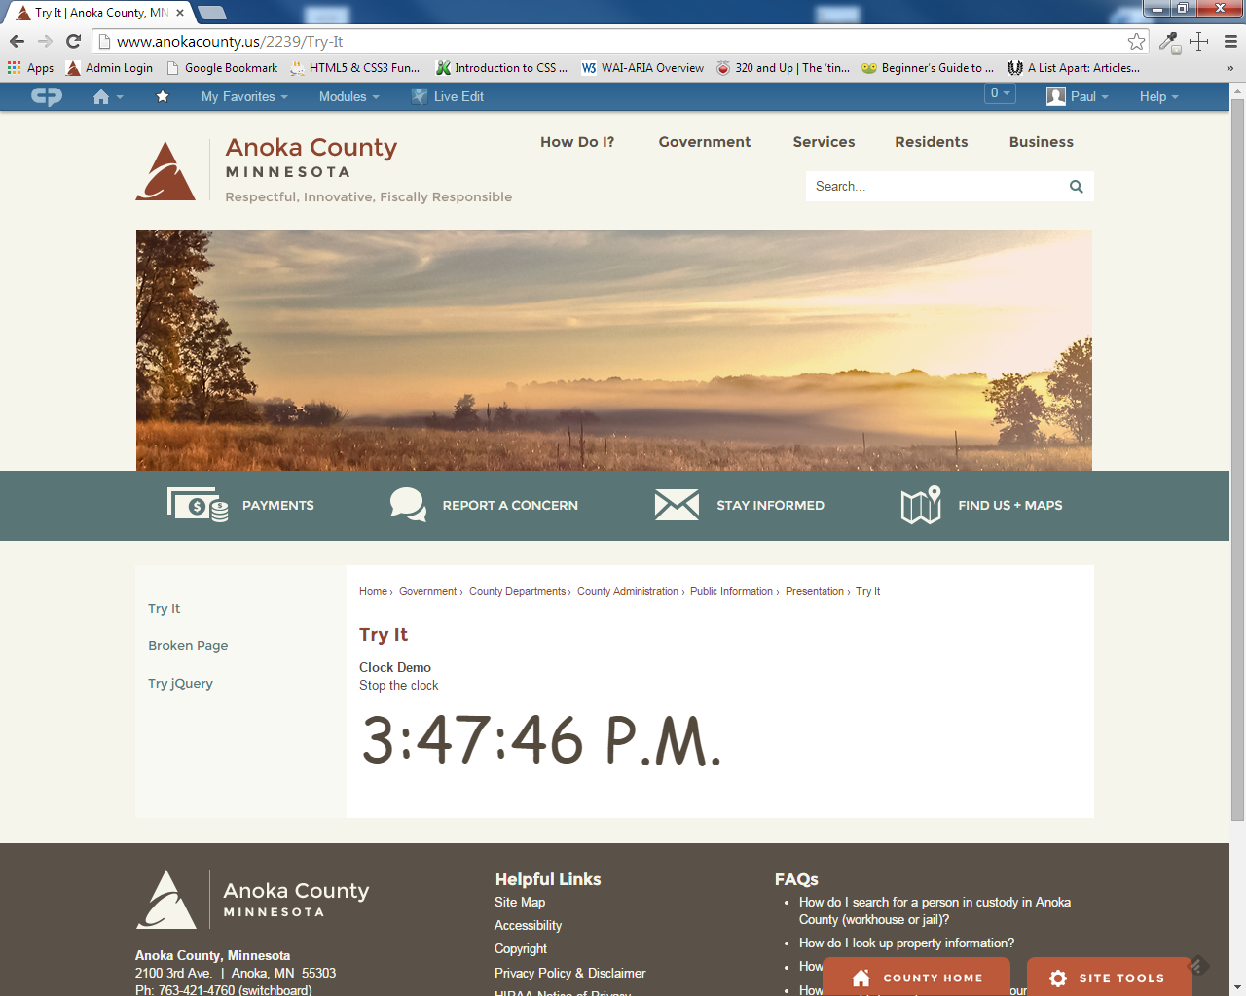

Slide 17
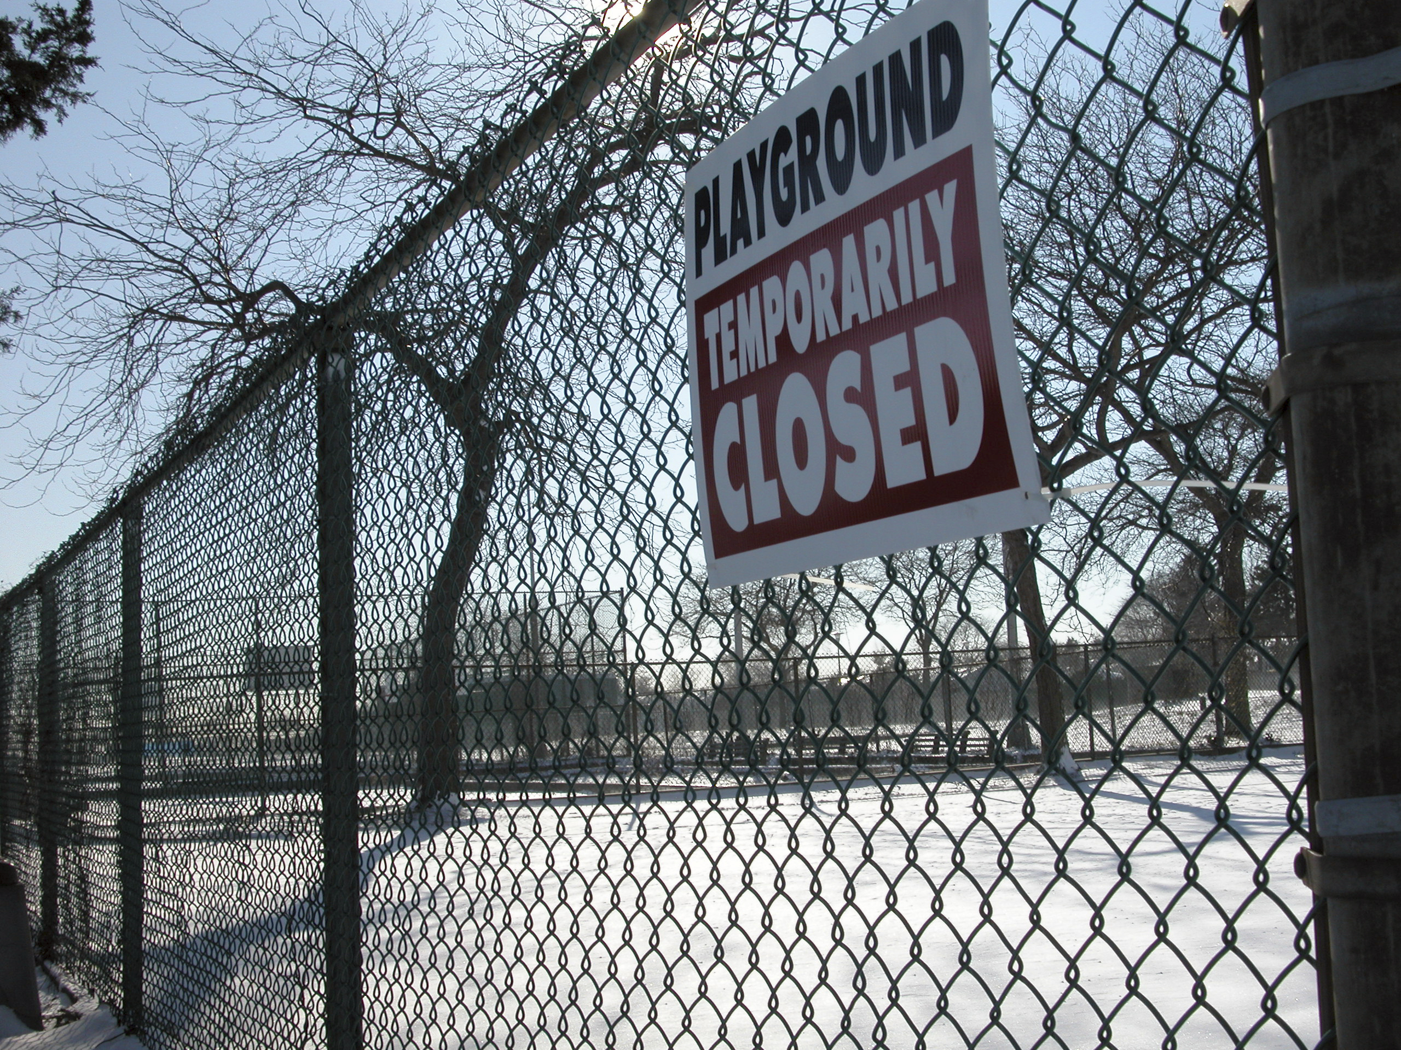

Slide 18

Why can’t you play?
Security risk of script insertion
Interference with other scripts on the page
Vendor quality control
Just because

Slide 19
Why would they let you play?
Response from vendor: CivicPlus
Allow for flexibility when needed without overwhelming basic users with too many options
Maintain security through permission structures, workflows and server-level security
Document center allows for CSV and CSS files

Slide 20


Slide 21
What do you have to play with?
JavaScript – statements, functions, objects, DOM interaction, etc.
JavaScript Libraries – example: jQuery
Use "View Source" or "Inspect Element" to see if jQuery is loaded
Try simple code to see if you can use it demo – http://www.anokacounty.us/tryjquery

Slide 22
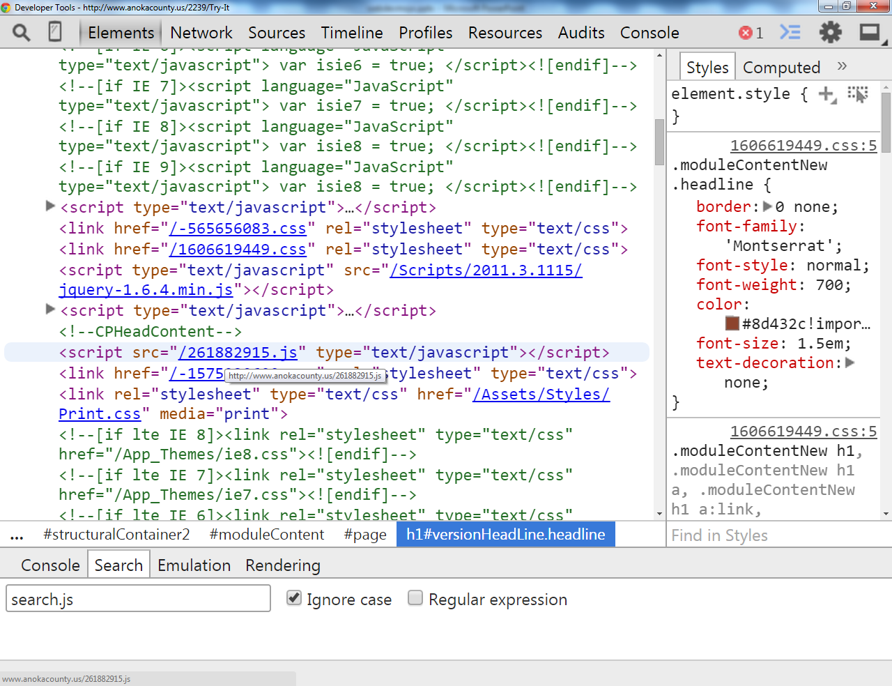

Slide 23
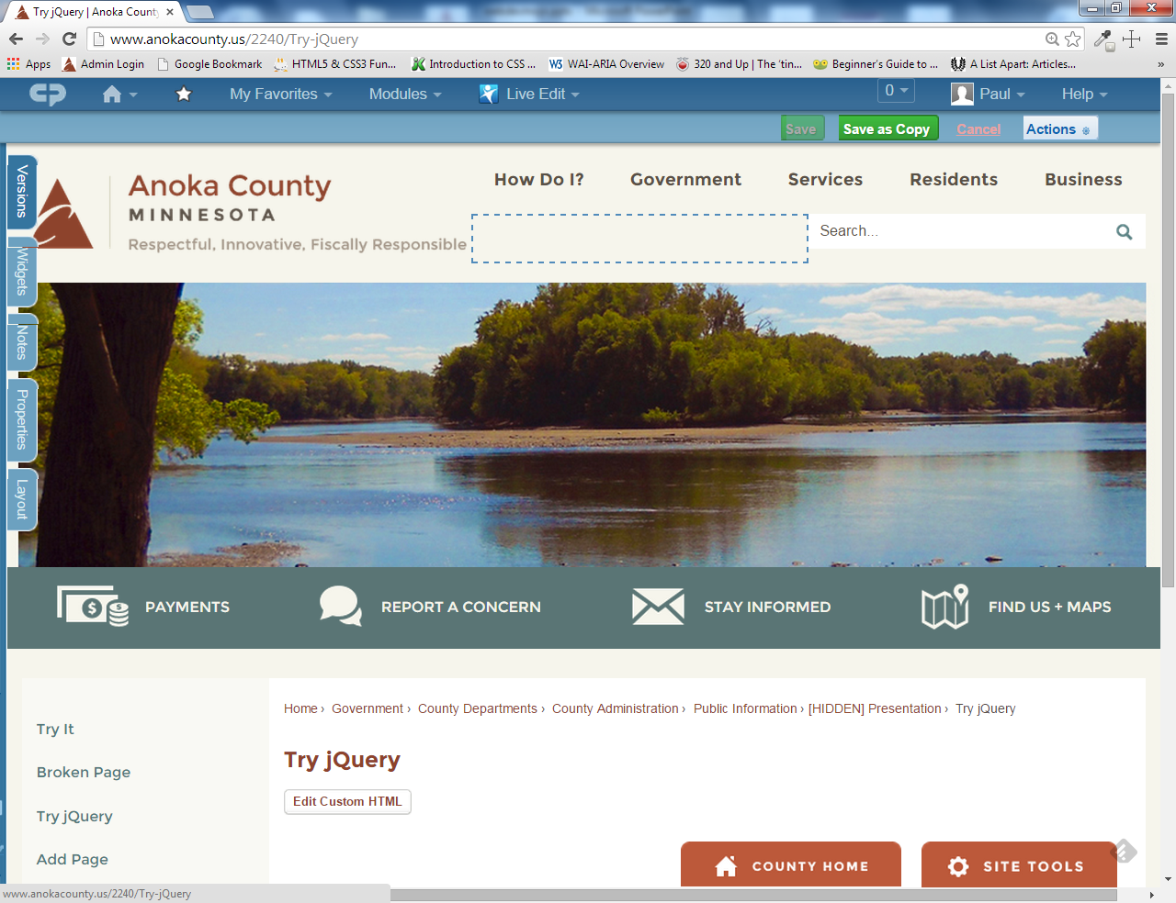

Slide 24
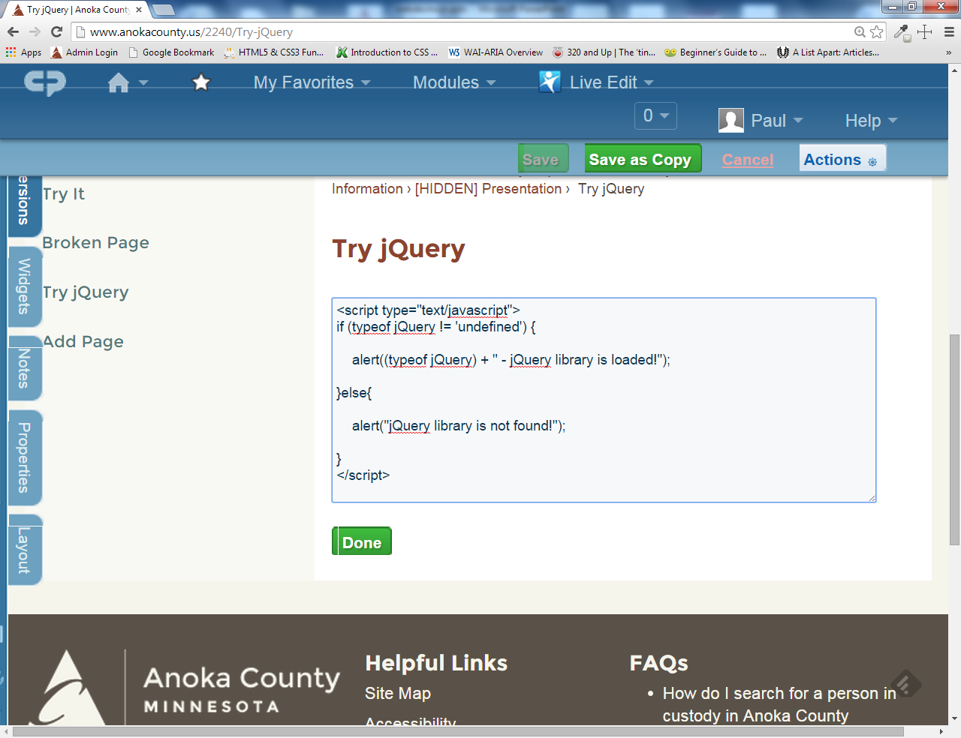

Slide 25
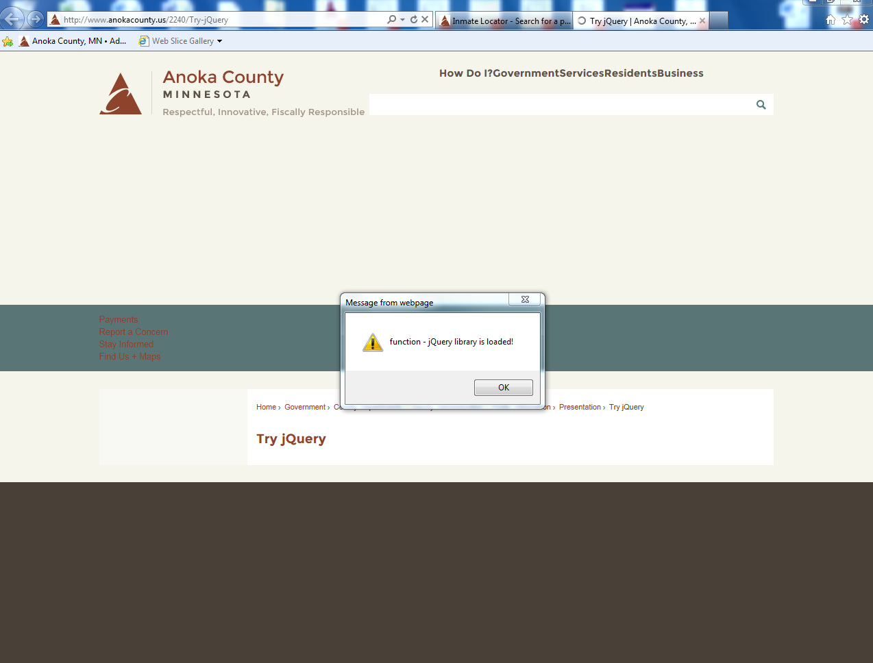

Slide 26

Plays well with others

Slide 27
How do you “play well with others?”
Problem – If your CMS uses JavaScript, your code can break the page (but not the CMS)
Reason – By default all JavaScript on the page is global
Consequences – You can overwrite existing variables and functions on the page, or the page can overwrite yours demo – http://www.anokacounty.us/youbrokeit

Slide 28
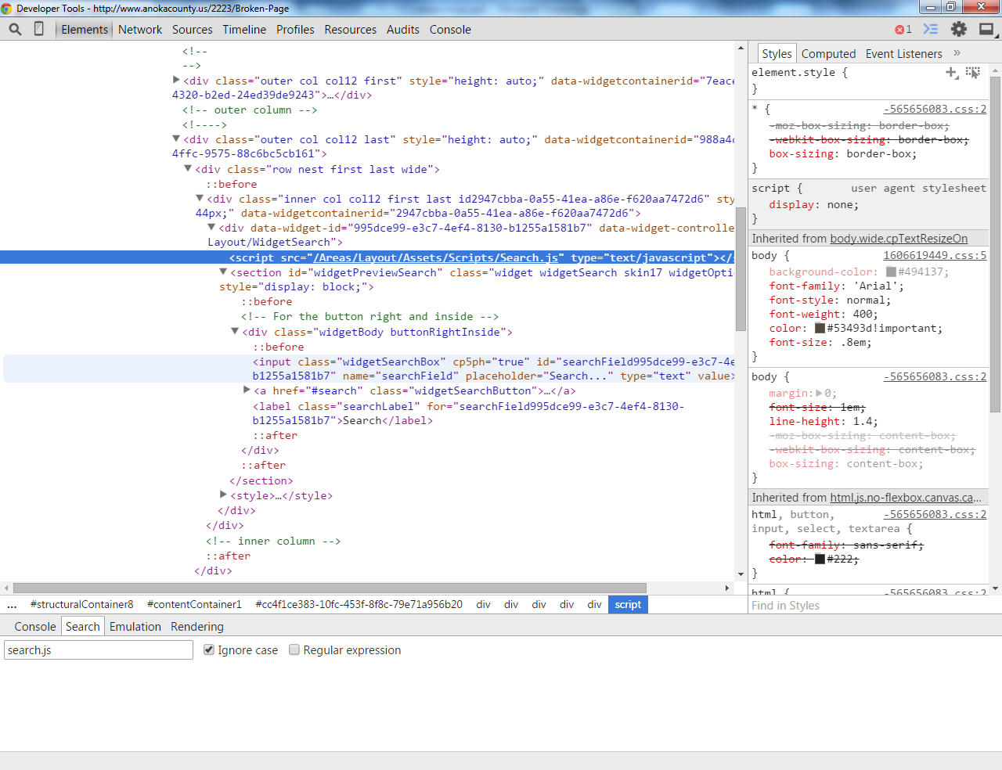

Slide 29
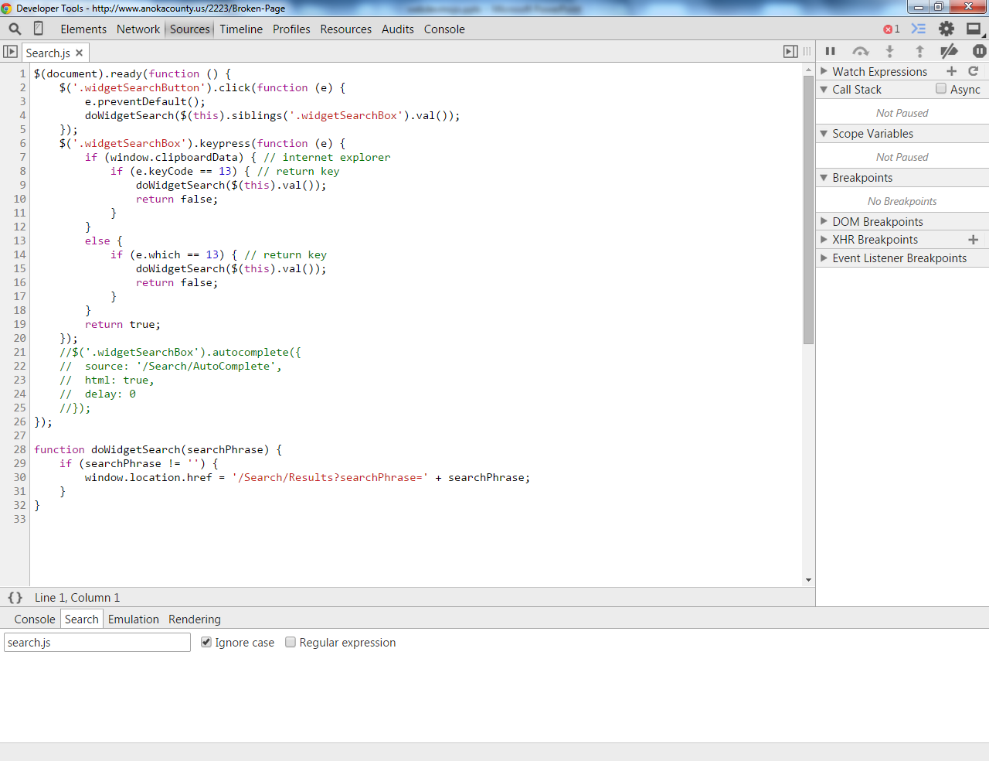

Slide 30
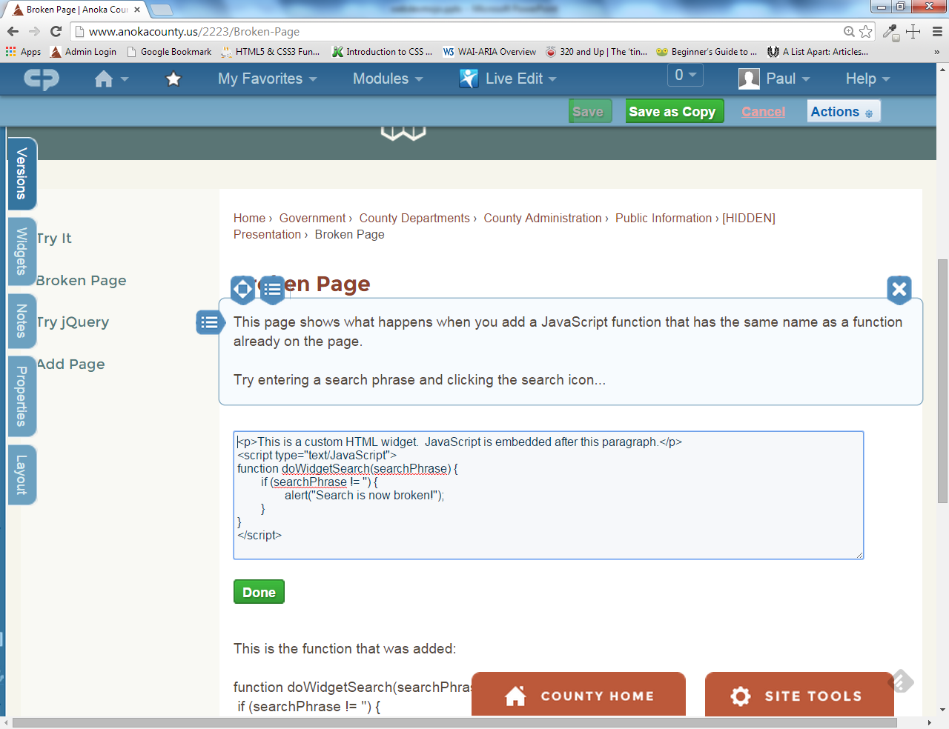

Slide 31
How do you “play well with others?”
Solution – Create a JavaScript “namespace,” a single global object that contains all your variables and functions
Reference - http://www.kenneth-truyers.net/2013/04/27/javascript-namespaces-and-modules/
Code walkthrough

Slide 32
Why would you want to play?
Customize design
Include information from other sources on your site (JSONP and CORS)
Enhanced use of information from your site (RSS and site API)
Custom solutions

Slide 33
Patterns
Change page design http://www.anokacounty.us/2092/Charitable-Giving-Campaign http://www.anokacounty.us/list.aspx
Use referrer code http://www.anokacounty.us/355/Integrated-Waste-Management
Use a data document http://www.anokacounty.us/278/Estimated-Tax-Calculator
Display data from another system http://www.anokacounty.us/1405/Adult-Trial-Updates http://www.anokacounty.us/727/Inmate-Locator

Slide 34
Keep it accessible
Cognitive – simple and straightforward
Physical – mouse and keyboard interface, touch friendly
Vision – dynamic content http://www.w3.org/WAI/intro/aria.php http://speckyboy.com/2013/02/04/myths-about-how-blind-people-use-the-internet/

Slide 35
Working environment
IDE – Visual Studio Express, Brackets, Webstorm
Method – build/test in a stand-alone page
Method – test/refine in a live page
Version Control – create a project and track versions using git (github.com or bitbucket.com) or other VCS
Tracking – keep a list of pages with JavaScript

Slide 36

Thank You!

Slide 37
Thank You!
Paul Burtness Anoka County Website Coordinator Paul.Burtness@co.anoka.mn.us 763-323-5732 www.anokacounty.us Presentation and code samples at: http://paul-burtness.github.io/webdevmojo

